Slide 1
Text Classification
Dr. Alaa Sheta

Slide 2
What Classification is and is not
Classification (a.k.a. “categorization”): a ubiquitous enabling technology in data science; studied within pattern recognition, statistics, and machine learning.
Def: the activity of predicting to which among a predefined finite set of groups (“classes”, or “categories”) a data item belongs to
Formulated as the task of generating a hypothesis (or “classifier”, or “model”)
h : D → C
where D = {x₁, x₂, ...} is a domain of data items and C = {c₁, ..., c_{n}} is a finite set of classes (the classification scheme, or codeframe)

Slide 3
What Classification is and is not (cont’d)
Different from clustering, where the groups (“clusters”) and their number are not known in advance
The membership of a data item into a class must not be determinable with certainty (e.g., predicting whether a natural number belongs to Prime or NonPrime is not classification); classification always involves a subjective judgment
In text classification, data items are textual (e.g., news articles, emails, tweets, product reviews, sentences, questions, queries, etc.) or partly textual (e.g., Web pages)

Slide 4
Main Types of Classification
Binary classification: h : D → C (each item belongs to exactly one class) and
C = {c₁, c₂}
E.g., assigning emails to one of {Spam, Legitimate}
Single-Label Multi-Class (SLMC) classification: h : D → C (each item
belongs to exactly one class) and C = {c₁, ..., c_{n}}, with n > 2
E.g., assigning news articles to one of {HomeNews, International, Entertainment, Lifestyles, Sports}
Multi-Label Multi-Class (MLMC) classification: h : D → 2^{C} (each item may belong to zero, one, or several classes) and C = {c₁, ..., c_{n}}, with n > 1
E.g., assigning computer science articles to classes in the ACM Classification System
May be solved as n independent binary classification problems
Ordinal classification (OC): as in SLMC, but for the fact that there is a total order c₁ ... c_{n} on C = {c₁, ..., c_{n}}
E.g., assigning product reviews to one of {Disastrous, Poor, SoAndSo, Good, Excellent}

Slide 5
Hard Classification and Soft Classification
The definitions above denote “hard classification” (HC)
“Soft classification” (SC) denotes the task of predicting a score for each pair
(d, c), where the score denotes the { probability / strength of evidence /
confidence } that d belongs to c
E.g., a probabilistic classifier outputs “posterior probabilities” Pr(c|d ) ∈ [0, 1]
E.g., the AdaBoost classifier outputs scores s(d, c) ∈ (−∞, +∞) that represent its confidence that d belongs to c
When scores are not probabilities, they can be converted into probabilities via the use of a sigmoidal function; e.g., the logistic function:
1
_{1 + e}σh(d,c)+β
Pr(c|d ) =

Slide 6
Hard Classification and Soft Classification (cont’d)
σ =0.20
σ =0.42
σ =1.00
σ =2.00
σ =3.00
1.0
0.8
0.6
0.4
0.2
-10.0 -8.0 -6.0 -4.0 -2.0 0.0
2.0
4.0
6.0
8.0
10.0
-0.2

Slide 7
Hard Classification and Soft Classification (cont’d)
Hard classification often consists of
Training a soft classifier that outputs scores s(d, c)
Picking a threshold t, such that
s(d, c) ≥ t is interpreted as predicting c1
s(d, c) < t is interpreted as predicting c2
In soft classification, scores are used for ranking; e.g.,
ranking items for a given class
ranking classes for a given item
HC is used for fully autonomous classifiers, while SC is used for interactive classifiers (i.e., with humans in the loop)

Slide 8
Dimensions of Classification
Text classification may be performed according to several dimensions (“axes”) orthogonal to each other
by topic ; by far the most frequent case, its applications are ubiquitous
by sentiment ; useful in market research, online reputation management, customer relationship management, social sciences, political science
by language (a.k.a. “language identification”); useful, e.g., in query processing within search engines
by genre ; e.g., AutomotiveNews vs. AutomotiveBlogs, useful in website classification and others;
by author (a.k.a. “authorship attribution”), or by native language (“native language identification”); useful in forensics and cybersecurity
...

Slide 9
Example 1: Knowledge Organization
Long tradition in both science and the humanities ; goal was organizing knowledge, i.e., conferring structure to an otherwise unstructured body of knowledge
The rationale is that using a structured body of knowledge is easier / more effective than if this knowledge is unstructured
Automated classification tries to automate the tedious task of assigning data items based on their content, a task otherwise performed by human annotators (a.k.a. “assessors”, or “coders”)

Slide 10
Example 1: Knowledge Organization (cont’d)
Scores of applications; e.g.,
Classifying news articles for selective dissemination
Classifying scientific papers into specialized taxonomies
Classifying patents
Classifying “classified” ads
Classifying answers to open-ended questions
Classifying topic-related tweets by sentiment
...
Retrieval (as in search engines) could also be viewed as (binary + soft) classification into Relevant vs. NonRelevant

Slide 11
Example 2: Filtering
Filtering (a.k.a. “routing”) using refers to the activity of blocking a set of NonRelevant items from a dynamic stream, thereby leaving only the Relevant ones
E.g., spam filtering is an important example, attempting to tell Legitimate
messages from Spam messages¹
Detecting unsuitable content (e.g., porn, violent content, racist content, cyberbullying, fake news) is also an important application, e.g., in PG filters or on interfaces to social media
Filtering is thus an instance of binary (usually: hard) classification, and its applications are ubiquitous
¹Gordon V. Cormack: Email Spam Filtering: A Systematic Review. Foundations and Trends in Information Retrieval 1(4):335–455 (2006)

Slide 12
Example 3: Empowering other IR Tasks
Functional to improving the effectiveness of other tasks in IR or NLP; e.g.,
Classifying queries by intent within search engines
Classifying questions by type in question answering systems
Classifying named entities
Word sense disambiguation in NLP systems
...
Many of these tasks involve classifying very small texts (e.g., queries, questions, sentences), and stretch the notion of “text” classification quite a bit ...

Slide 13
The Supervised Learning Approach to Classification
An old-fashioned way to build text classifiers was via knowledge engineering,
i.e., manually building classification rules
E.g., (Viagra or Sildenafil or Cialis) → Spam
Disadvantages: expensive to setup and to mantain
Superseded by the supervised learning (SL) approach
A generic (task-independent) learning algorithm is used to train a classifier from a set of manually classified examples
The classifier learns, from these training examples, the characteristics a new
text should have in order to be assigned to class c
Advantages:
Annotating / locating training examples cheaper than writing classification rules
Easy update to changing conditions (e.g., addition of new classes, deletion of existing classes, shifted meaning of existing classes, etc.)

Slide 14
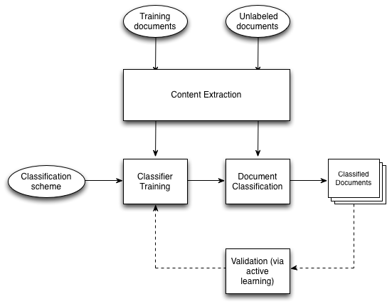
The Supervised Learning Approach to Classification

Slide 15
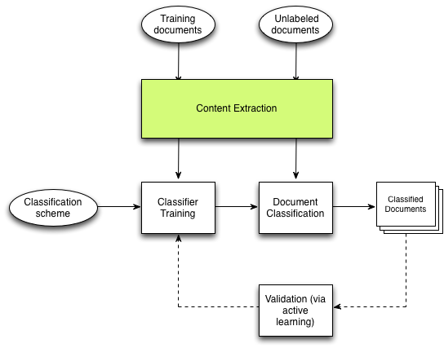
The Supervised Learning Approach to Classification

Slide 16
Representing Text for Classification Purposes
In order to be input to a learning algorithm (or a classifier), all training (or unlabeled) documents are converted into vectors in a common vector space
The dimensions of the vector space are called features (or terms, or covariates), and the number K of features used is called the dimensionality of the vector space
In order to generate a vector-based representation for a set of documents D,
the following steps need to be taken
Feature Design and Extraction
(Feature Selection or Feature Synthesis)
Feature Weighting

Slide 17
Representing Text: 1. Feature Design and Extraction
In classification by topic, a typical choice is to make the set of features coincide with the set of words that occur in the training set (unigram model,
a.k.a. “bag-of-words”)
This may be preceded by (a) stop word removal and/or (b) stemming or lemmatization; (b) is meant to improve statistical robustness
The dimensionality K of the vector space is the number of words (or stems, or lemmas) that occur at least once in the training set, and can easily be O(10⁵)
But each document usually contains O(10⁵) unique words! If we indicate the absence of a word from a document by 0, this means that these vectors are usually very “sparse”
Vector sparsity and high dimensionality are possibly the two most important characteristics that distinguish text classification from other instantiations of classification (e.g., in data mining)

Slide 18
Representing Text: 1. Feature Design and Extraction
Word n-grams (i.e., sequences of n words that frequently occur in D – a.k.a. “shingles”) may be optionally added; this is usually limited to n = 2 (unigram+bigram model)
Word Unigrams
A swimmer likes swimming thus he swims
A
swimmer
likes swimming thus he swims
A swimmer likes swimming thus he swims
A swimmer likes swimming thus he swims
...
Word Bigrams
A swimmer likes swimming thus he swims A swimmer likes swimming thus he swims
A swimmer likes swimming thus he swims
A swimmer likes swimming thus he swims
...
The higher the value of n, the higher the semantic significance and the dimensionality K of the resulting representation, and the lower its statistical robustness

Slide 19
Representing Text: 1. Feature Design and Extraction
An alternative to the process above is to make the set of features coincide with the set of character n-grams (e.g., n ∈ {3, 4, 5}) that occur in D; useful especially for degraded text (e.g., resulting from OCR or ASR)²
Character 5-grams
It was a dark and stormy night a dark and stormy night
It was
It was a dark and stormy night It was a dark and stormy night
It was a dark and stormy night
It was a dark and stormy night
...
In order to achieve statistical robustness, all of the representations discussed so far renounce encoding word order and syntactic structure
²Paul McNamee, James Mayfield: Character N-Gram Tokenization for European Language Text Retrieval. Information Retrieval 7(1-2):73-97 (2004)

Slide 20
Representing Text: 1. Feature Extraction
The above is OK for classification by topic, but not necessarily when classifying by other dimensions!
E.g.
in classification by author, features such average word length, average sentence length, punctuation frequency, frequency of subjunctive clauses, etc., are used³
³Patrick Juola: Authorship Attribution. Foundations and Trends in Information Retrieval
1(3): 233-334 (2006)

Slide 21
Representing Text: 1. Feature Extraction
The above is OK for classification by topic, but not necessarily when classifying by other dimensions!
E.g.
in classification by author, features such average word length, average sentence length, punctuation frequency, frequency of subjunctive clauses, etc., are used³
Jesus saith unto them, Did ye never read in the scriptures, The stone which the builders rejected, the same is become the head of the corner: this is the Lord’s doing.
(Matthew 21:42)
³Patrick Juola: Authorship Attribution. Foundations and Trends in Information Retrieval
1(3): 233-334 (2006)

Slide 22
Representing Text: 1. Feature Extraction
The above is OK for classification by topic, but not necessarily when classifying by other dimensions!
E.g.
in classification by author, features such average word length, average sentence length, punctuation frequency, frequency of subjunctive clauses, etc., are used³
Jesus saith unto them, Did ye never read in the scriptures, The stone which the builders rejected, the same is become the head of the corner: this is the Lord’s doing.
(Matthew 21:42)
In classification by sentiment, bag-of-words is not enough, and deeper linguistic processing is necessary
The choice of features for a classification task (feature design) is dictated by the distinctions we want to capture, and is left to the designer.
³Patrick Juola: Authorship Attribution. Foundations and Trends in Information Retrieval
1(3): 233-334 (2006)

Slide 23
Representing Text: 2a. Feature selection
Vectors of length O(10⁵) or O(10⁶) might result, esp. if word n-grams are used, in both “overfitting” and high computational cost;
Feature selection (FS) has the goal of identifying the most discriminative features, so that the others may be discarded
The “filter” approach to FS consists in measuring (via a function ξ) the discriminative power ξ(t_{k} ) of each feature t_{k} and retaining only the
top-scoring features⁴
For binary classification, a typical choice for ξ is mutual information, i.e.,
X X
Pr(t, c)
² Pr(t) Pr(c)
MI (t , c ) = Pr(t, c) log
k i
c∈{ci ,ci } t∈{t_{k} ,t_{k} }
Alternative choices are chi-square and log-odds.
⁴Y. Yang, J. Pedersen: A Comparative Study on Feature Selection in Text Categorization.
Proceedings of ICML 1997.

Slide 24
Representing Text: 2b. Feature Synthesis
Matrix decomposition techniques (e.g., PCA, SVD, LSA) can be used to synthesize new features that replace the features discussed above with ones not suffering from ambiguity and polisemy
These techniques are based on the principles of distributional semantics, which states that the semantics of a word “is” the words it co-occurs with in corpora of language use
You shall know a word by the company it keeps
(John R. Firth, 1957)
Pros: the synthetic features in the new vectorial representation do not suffer from polisemy or synonymy
Cons: computationally expensive, sometimes prohibitively so
Word embeddings: the “new wave of distributional semantics”, as from “deep learning”⁵
⁵Mikolov, T.; Sutskever, I.; Chen, K.; Corrado, G.; and Dean, J. Distributed representations of words and phrases and their compositionality. NIPS, 2013.

Slide 25
Representing Text: 3. Feature Weighting
Feature weighting means attributing a value x_{ik} to feature t_{k} in the vector x_{i}
that represents document d_{i} : this value may be
binary (representing presence/absence of tk in di ); or
numeric (representing the importance of tk for di ); obtained via feature weighting functions in the following two classes:
unsupervised : e.g, tf ∗ idf or BM25,
supervised : e.g., tf ∗ MI , tf ∗ χ²
The similarity between two vectors may be computed via cosine similarity
P
K
i =1
xi 1 · xi 2
sim(x , x ) =
P
P
1 2
K
2
1
K
2
1
( x ) ( x )
i =1 i 1 ² i =1 i 2 ²
If these vectors are pre-normalized, this is equivalent to computing their dot product
K
X
sim(x , x ) = x · x
1 2 i 1 i 2
i =1

Slide 26
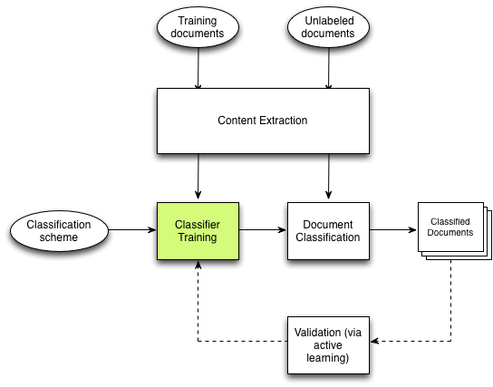
The Supervised Learning Approach to Classification

Slide 27
Supervised Learning for Binary Classification
For binary classification, essentially any supervised learning algorithm can be
used for training a classifier; popular choices include
Support vector machines (SVMs)
Boosted decision stumps
Logistic regression
Na¨ıve Bayesian methods
Lazy learning methods (e.g., k-NN)
...
The “No-free-lunch principle” (Wolpert, 1996): ≈ there is no learning algorithm that can outperform all others in all contexts
Implementations need to cater for
the very high dimensionality typical of TC
the sparse nature of the representations involved

Slide 28
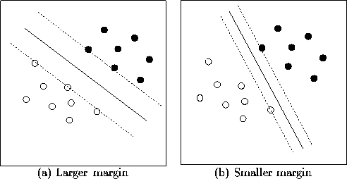
An Example Supervised Learning Method: SVMs
A constrained optimization problem: find the separating surface (e.g., hyperplane) that maximizes the margin (i.e., the minimum distance between the hyperplane and the training examples)
Margin maximization conducive to good generalization accuracy on unseen data
Theoretically well-founded + good empirical performance on a variety of tasks
Publicly available implementations optimized for high-dimensional, sparse feature spaces: e.g., SVM-Light, LibSVM, LibLinear,

Slide 29
An Example Supervised Learning Method: SVMs (cont’d)
We consider linear separators (i.e., hyperplanes) and classifiers of type
h(x) = sign(w · x + b)
Hard-margin SVMs look for
1
arg min w · w
such that
w≥0
2
y_{i} [w · x_{i} + b] ≥ 0
for all i ∈ {1, ..., |L|}
There are now fast algorithms for this⁶
⁶T. Joachims, C.-N. Yu: Sparse kernel SVMs via cutting-plane training. Machine Learning, 2009.

Slide 30
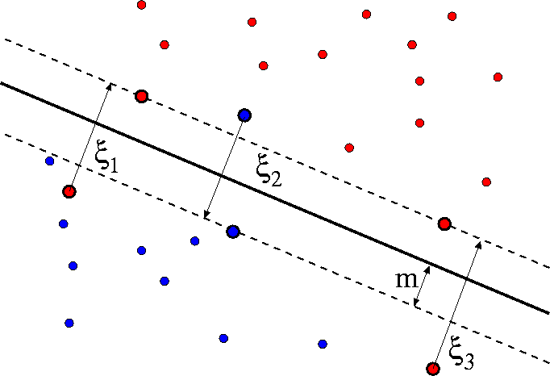
An Example Supervised Learning Method: SVMs (cont’d)
Classification problems are often not linearly separable (LS)
Soft-margin SVMs introduce penalties for misclassified training examples; they look for
|L|
1
2
X
arg min
w,ξ_{i} ≥0
such that
w · w + C ξ
i
i =1
y_{i}⁰[w · x⁰_{i} + b] ≥ (1 − ξ_{i} )
for all i ∈ {1, ..., |L|}

Slide 31
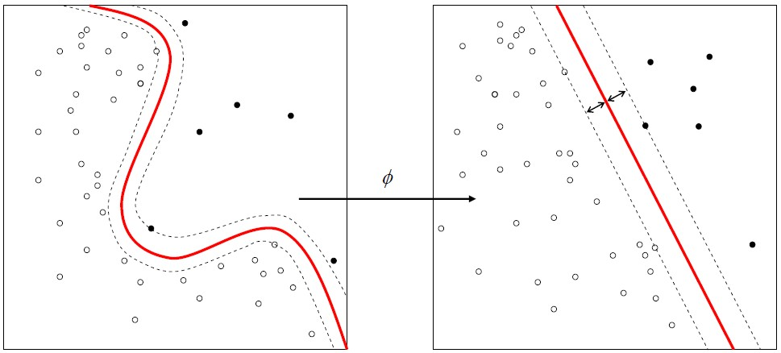
An Example Supervised Learning Method: SVMs (cont’d)
Non-LS problems can become LS once mapped to a high-dimensional space

Slide 32
An Example Supervised Learning Method: SVMs (cont’d)
Kernels are similarity functions K (x_{i} , x_{j} ) = φ(x_{i} ) · φ(x_{j} ), where φ(·) is a mapping into a higher-dimensional space
SVMs can indeed use kernels instead of the standard dot product; popular kernels are
K (xi , xj ) = xi · xj
(the linear kernel) (the polynomial kernel) (the RBF kernel)
(the sigmoid kernel)
K (xi , xj ) = (γxi · xj + r )^{d} , γ > 0
K (xi , xj ) = exp(−γ||xi − xj ||²), γ > 0
K (xi , xj ) = tanh(γxi · xj + r )
However, the linear kernel is usually employed in text classification applications; there are theoretical arguments supporting this⁷.
⁷T. Joachims: A Statistical Learning Model of Text Classification for Support Vector Machines. Proceedings of SIGIR 2001.

Slide 33
Supervised Learning for Non-Binary Classification
Some learning algorithms for binary classification are “SLMC-ready”; e.g.
Decision trees
Boosted decision stumps
Logistic regression
Naive Bayesian methods
Lazy learning methods (e.g., k-NN)
For other learners (notably: SVMs) to be used for SLMC classification, combinations / cascades of the binary versions need to be used⁸
For ordinal classification, algorithms customised to OC need to be used (e.g., SVORIM, SVOREX)⁹
⁸K. Crammer and Y. Singer. On the Algorithmic Implementation of Multi-class SVMs,
Journal of Machine Learning Research, 2001.
⁹Chu, W., Keerthi, S.: Support vector ordinal regression. Neural Computation, 2007.

Slide 34
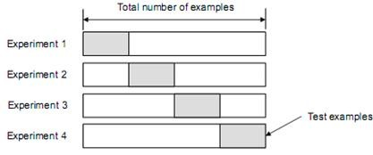
Parameter Optimization in Supervised Learning
The trained classifiers often depend on one or more parameters: e.g.,
The C parameter in soft-margin SVMs
The γ, r , d parameters of non-linear kernels
...
These parameters need to be optimized, e.g., via k-fold cross-validation on the training set

Slide 35
Evaluating a Classifier
Two important aspects in the evaluation of a classifier are efficiency and effectiveness
Efficiency refers to the consumption of computational resources, and has two aspects
Training efficiency (also includes time devoted to performing feature selection and parameter optimization)
Classification efficiency; usually considered more important than training efficiency, since classifier training is carried out (a) offline and (b) only once
For evaluating a text classifier it is good practice to consider both training costs and classification costs

Slide 36
Effectiveness
Effectiveness (a.k.a. accuracy) refers to how frequently classification decisions taken by a classifier are “correct”
Usually considered more important than efficiency, since accuracy issues “are there to stay”
Effectiveness tests are carried out on one or more datasets meant to simulate operational conditions of use
The main pillar of effectiveness testing is the evaluation measure we use

Slide 37
Evaluation Measures for Classification
Each type of classification (binary/SLMC/MLMC/ordinal) and mode of classification (hard/soft) requires its own measure
For binary (hard) classification, given the contingency table Ω
 |  | true
 |  | Yes | No
pred | Yes | TP | FP
 | No | FN | TN
TP
the standard measure is F₁, the harmonic mean of precision (π = _{TP + FP} )
TP
and recall (ρ =
), i.e.,
TP + FN
 πρ 2TP
2TP + FP + FN
1

=
if TP + FP + FN > 0
F1 = π + ρ

if TP = FP = FN = 0
F₁ is robust to the presence of imbalance in the test set

Slide 38
Evaluation Measures for Classification (cont’d)
For multi-label multi-class classification, F₁ must be averaged across the
classes, according to
micro-averaging: compute F1 from the “collective” contingency table obtained by summing cells
 |  | true
 |  | Yes | No
predicted | Yes | ^{X} TPi c_{i} ∈C | ^{X} FPi c_{i} ∈C
 | No | ^{X} FNi c_{i} ∈C | ^{X} TNi c_{i} ∈C
macro-averaging: compute F1(ci ) for all ci ∈ C and then average
Micro usually gives higher scores than macro ...

Slide 39
Evaluation Measures for Classification (cont’d)
For single-label multi-class classification, the most widely used measure is
(“vanilla”) accuracy
P
Ω
ii
A =
c ∈C
i
|U|
where Ω_{ij} is the number of documents in c_{i} which are predicted to be in c_{j}
 |  | true
 |  | c₁ | ... | ^{c}|C|
pred | c₁ | Ω11 | ... | ^{Ω}1|C|
 | ... | ... | ... | ...
 | ^{c}|C| | ^{Ω}|C|1 | ... | ^{Ω}|C||C|

Slide 40
Evaluation Measures for Classification (cont’d)
For ordinal classification, the measure must acknowledge that different errors may have different weight; the most widely used one is macroaveraged mean absolute error, i.e.,
n
X X
1 1
M
MAE (h, U) =
|h(x ) − y )|
n |U_{i} |
j i
i =1 x_{j} ∈U_{i}
For soft classification, measures from the tradition of ad hoc retrieval are used. E.g., for soft single-label multi-class classification, mean reciprocal ranking can be used, i.e.,
1 ^{X} 1
|U| _{xj ∈U} r_{h} (y_{i} )
MRR(h, U) =

Slide 41
Some Datasets for Evaluating Text Classification
 | Total examples | Training examples | Test examples | Classes | Hierarchical | Language | Type
Reuters-21578 | ≈ 13,000 ≈ 800,000 ≈ 20,000 ≈ 16,000 ≈ 15,700 ≈ 83,700 | ≈ 9,600 ≈ 20,000 — ≈ 12,500 ≈ 10,500 ≈ 20,000 | ≈ 3,200 ≈ 780,000 — ≈ 3,500 ≈ 5,200 ≈ 63,700 | 115 | No | EN | MLMC
RCV1-v2 |  |  |  | 99 | Yes | EN | MLMC
20Newsgroups |  |  |  | 20 | Yes | EN | MLMC
OHSUMED-S |  |  |  | 97 | Yes | EN | MLMC
TripAdvisor-15763 |  |  |  | 5 | No | EN | Ordinal
Amazon-83713 |  |  |  | 5 | No | EN | Ordinal

Slide 42
Want to Experiment with Text Classification?
Several publicly available environments where to play with text preprocessing routines, feature selection functions, feature weighting functions, learning algorithms, etc. E.g.,
scikit-learn (http://scikit-learn.org/): Python-based, features various classification, regression and clustering algorithms including SVMs, random forests, gradient boosting, k-means (...), and is designed to interoperate with the Python numerical and scientific libraries NumPy and SciPy.
Weka (https://www.cs.waikato.ac.nz/ml/weka/): Java-based, features various algorithms for data analysis and predictive modeling.

Slide 43
Text Classification
1 The Task
2 Applications of Text Classification
3 Supervised Learning and Text Classification
Representing Text for Classification Purposes
Training a Classifier
4 Evaluating a Classifier
5 Advanced Topics

Slide 44
Advanced Topics (sketch)
Hierarchical classification
Classification when the classification scheme has a hierarchical nature
Hypertext classification (an application of “Relational Learning”)
Classification when the items are hypertextual (e.g., Web pages)
Cost-sensitive classification
Classification when false positives and false negatives are not equally bad
mistakes
Semi-supervised classification
When the classifier is trained using a combination of labelled and unlabelled
documents
Transductive classification
When we have all the unlabelled texts at training time

Slide 45
Advanced Topics (cont’d)
Cross-lingual text classification
Learning to classify documents in a language Lt from training data expressed in a language Ls
Semi-automated text classification
Optimizing the work of human assessors that need to review the results of
automated classification
Text quantification
Learning to estimate the distribution of the classes within the unlabelled data
Active learning for classification
When the items to label for training purposes are suggested by the system

Slide 46
Further Reading
General:
C. Aggarwal and C. Zhai: A Survey of Text Classification Algorithms. In C. Aggarwal and C. Zhai (eds.), Mining Text Data, pp. 163–222, Springer, 2012.
C. Aggarwal: Chapters 5–7 of Machine Learning for Text, Springer, 2018.
T. Joachims: Learning to Classify Text using Support Vector Machines.
Kluwer, 2002.
Supervised learning:
K. Murphy: Machine Learning: A Probabilistic Perspective. MIT Press, 2012.
T. Hastie, R. Tibshirani, J. Friedman: The Elements of Statistical Learning,
2nd Edition. Springer, 2009.
Evaluating the effectiveness of text classifiers:
N. Japkowicz and M. Shah: Evaluating Learning Algorithms: A Classification Perspective. Cambridge University Press, 2011.

Slide 47
Sentiment and Opinion Mining
Dr. Alaa Sheta

Slide 48

The Task
Sentiment Analysis and Opinion Mining: a set of tasks concerned with the analysing of texts according to the sentiments / opinions / emotions / judgments (private states, or subjective states) expressed in them
Originally, term “SA” had a more linguistic slant, while “OM” had a more applicative one
“SA” and “OM” largely used as synonyms nowadays

Slide 49
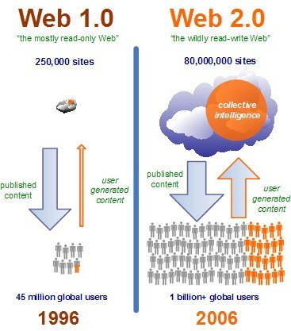
Opinion Mining and the Web 2.0 (cont.)
The 2000’s: Web 2.0 is born
Non-professional users also become authors of content, and this content is often opinion-laden.
With the growth of UGC, companies understand the value of these data (e.g., product reviews), and generate the demand for technologies capable of mining “sentiment” from them.
SA becomes the “Holy Grail” of market research, opinion research, and online reputation management.

Slide 50
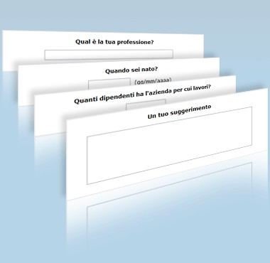
Opinion Research / Market Research via Surveys
Questionnaires may contain “open” questions
In many such cases the opinion dimension needs to be analysed, esp. in
social sciences surveys
political surveys
customer satisfaction surveys
Many such applications are instances of mixed topic / sentiment classification

Slide 51
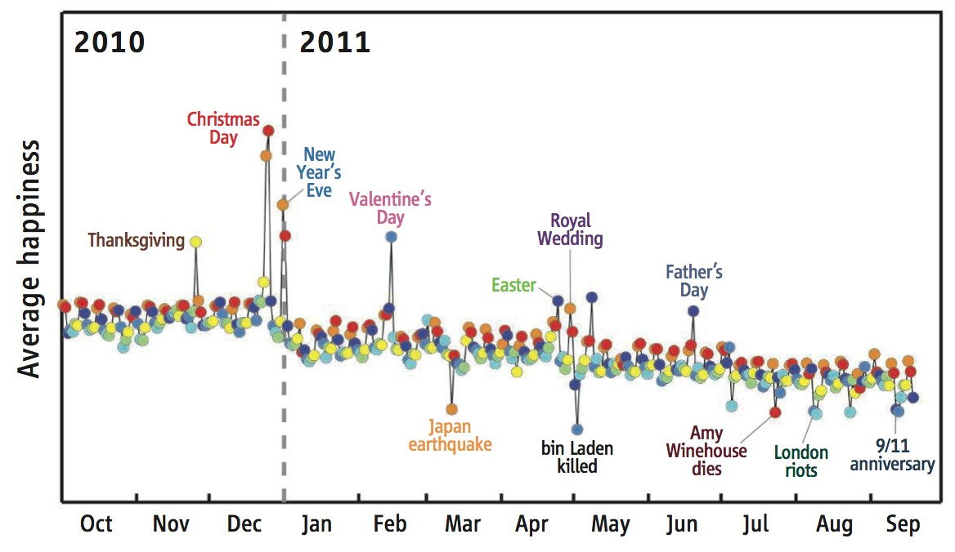
Computational Social Science

Slide 52
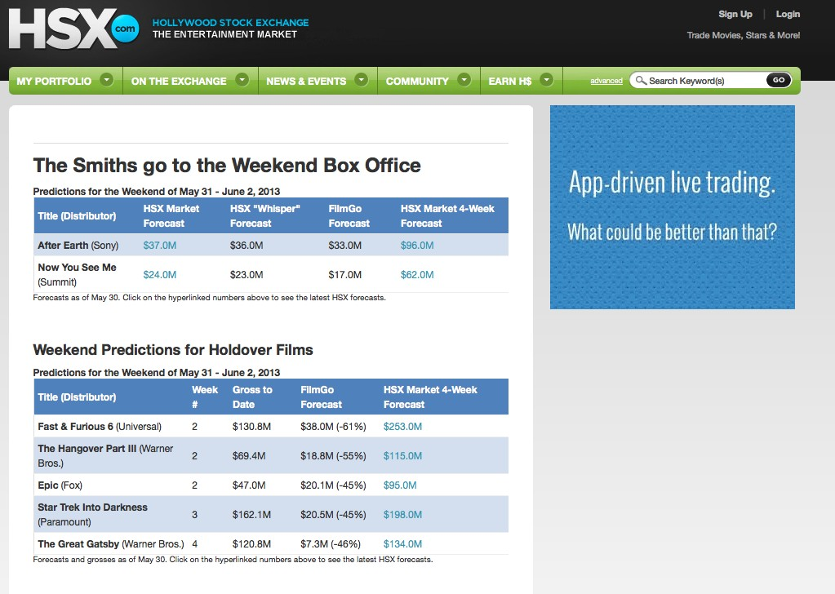
Market Research via Social Media Analysis

Slide 53
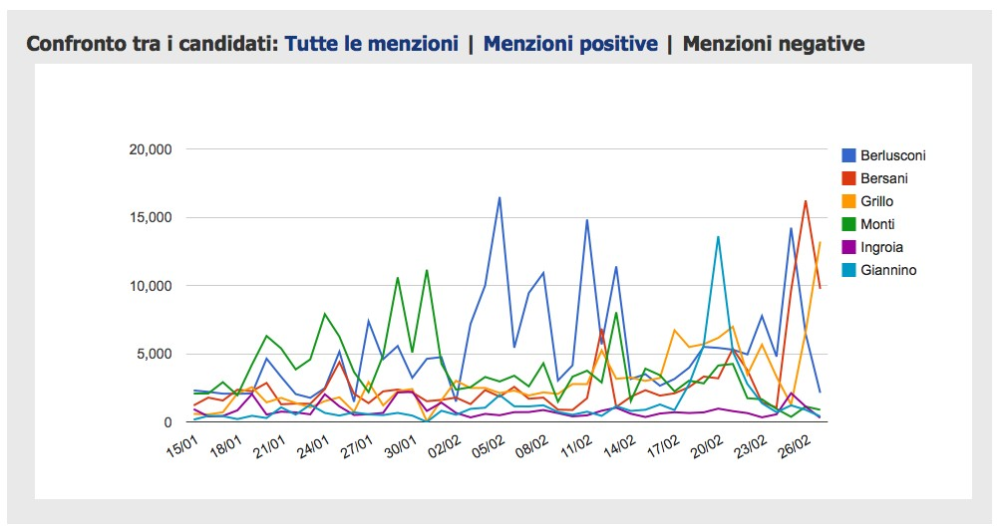
Political Science: Predicting Election Results

Slide 54

Online Reputation Detection / Management

Slide 55

Computational Advertising

Slide 56
How Difficult is Sentiment Analysis?
Sentiment analysis is inherently difficult, because in order to express opinions
/ emotions / etc. we often use a wide variety of sophisticated expressive means (e.g., metaphor, irony, sarcasm, allegation, understatement, etc.)
“At that time, Clint Eastwood had only two facial expressions: with the hat and without it.”
(from an interview with Sergio Leone)
“She runs the gamut of emotions from A to B”
(on Katharine Hepburn in “The Lake”, 1934)
“If you are reading this because it is your darling fragrance, please wear it at home exclusively, and tape the windows shut.”
(from a 2008 review of parfum “Amarige”, Givenchy)
Sentiment analysis could be characterised as an “NLP-complete” problem

Slide 57
Main Subtasks within SA / OM
Sentiment Classification: classify a piece of text based on whether it expresses a Positive / Neutral / Negative sentiment
Sentiment Lexicon Generation: determine whether a word / multiword conveys a Positive, Neutral, or Negative sentiment
Sentiment Quantification: given a set of texts, estimate the prevalence of different Positive, Neutral, Negative sentiments
Opinion Extraction (a.k.a. “Fine-Grained SA”): given an opinion-laden sentence, identify the holder of the opinion, its object, its polarity, the strength of this polarity, the type of opinion
Aspect-Based Sentiment Extraction: given an opinion-laden text about an object, estimate the sentiments conveyed by the text concerning different aspects of the object

Slide 58
Sentiment Classification
The “queen” of OM tasks
May be topic-biased or not
Classify items by sentiment; vs.
Find items that express an opinion about the topic, and classify them by their sentiment towards the topic
Binary, ternary, or n-ary (ordinal) versions
Ternary also involves Neutral or OK-ish (sometimes confusing the two ...)
Ordinal typically uses 1-Star, 2-Stars, 3-Stars, 4-Stars, 5-Stars as
classes
At the sentence, paragraph, or document level
Classification at the more granular levels used to aid classification at the less
granular ones
May be supervised or unsupervised

Slide 59
Sentiment Classification (cont’d)
Unsupervised Sentiment Classification (USC) relies on a sentiment lexicon
The first USC approaches just leveraged the number of occurrences of
Positive words and Negative words in the text
Approach later refined in various ways; e.g.,
If topic-biased, measure the distance between the sentiment-laden word and a word denoting the topic
Bring to bear valence shifters (e.g., particles indicating negated contexts such as not, hardly, etc.)
Bring to bear intensifiers (e.g., very, extremely) and diminishers (e.g.,
fairly)
Bring in syntactic analysis (and other levels of linguistic processing) to determine if sentiment really applies to the topic
Use WSD in order to better exploit sense-level sentiment lexicons

Slide 60
Sentiment Classification (cont’d)
Supervised Sentiment Classification (SSC) is just (single-label) text classification with sentiment-related polarities as the classes
Key fact: bag-of-words (or of-stems, or of-ngrams) does not lead anywhere ...
E.g., “A horrible hotel in a beautiful town!” vs. “A beautiful hotel in a horrible town!”
The same type of linguistic processing used for USC is also needed for SSC, with the goal of generating features for vectorial representations
→ “A hNegativei hotel in a hPositivei town!”
SSC tends to work better than USC, but requires training data; this has
spawned research into
Semi-supervised sentiment classification
Transfer learning for sentiment classification

Slide 61
Sentiment Lexicon Generation
The use of a sentiment lexicon is central to both USC and SSC (and to all other OM-related tasks)
Early sentiment lexicons were small, at the word level, and manually
annotated
E.g., the General Inquirer
SLs generated from corpora later become dominant;
Some of them are at the word sense level (e.g., SentiWordNet)
Some of them are medium-dependent (e.g., SLs for Twitter)
Some of them are domain-dependent (e.g., SLs for the financial domain)
Many of them are for languages other than English (e.g., SentiWordNet’s in other languages)

Slide 62
Sentiment Lexicon Generation (cont’d)
Several intuitions can be used to generate / extend a SL automatically; e.g.,
Conjunctions tend to indicate similar polarity (“cozy and comfortable”) or opposite polarity (“small but cozy”) (Hatzivassiloglou and McKeown, 1997)
Adjectives highly correlated to adjectives with known polarity tend to have the same polarity (Turney and Littman, 2003)
Synonyms (indicated as such in standard thesauri) tend to have the same polarity, while antonyms tend to have opposite polarity (Kim and Hovy, 2004)
Sentiment classification of words may be accomplished by classifying their definitions (Esuli and Sebastiani, 2005)
Words used in dictionary definitions tend to have the same polarity as the word being defined (Esuli and Sebastiani, 2007)
The main problem related to SLs is that the polarity of words / word senses is often context-dependent (e.g., warm blanket vs. warm beer; low interest rates vs. low ROI)

Slide 63
Opinion Extraction
Opinion Extraction (a.k.a. “Fine-Grained SA”): given an opinion-laden sentence, identify the holder of the opinion, its object, its polarity, the strength of this polarity, the type of opinion
An instance of information extraction, usually carried out via sequence learning (e.g., Conditional Random Fields, HM-SVMs)
More difficult than standard IE; certain concepts may be instantiated only implicitly

Slide 64
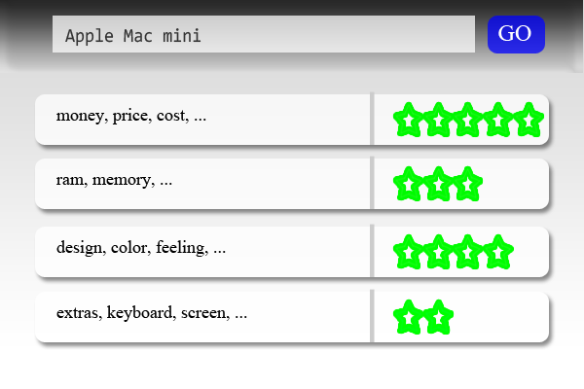
Aspect-Based Sentiment Extraction
Aspect-Based Sentiment Extraction: given an opinion-laden text about an object, estimate the sentiments conveyed by the text concerning different aspects of the object
Largely driven by need of mining / summarizing product reviews
Heavily based on extracting NPs (e.g., wide viewing angle) that are highly correlated with the product category (e.g., Tablet).
Aspects (e.g., viewing angle) and sentiments (e.g., wide) can be robustly identified via mutual reinforcement

Slide 65
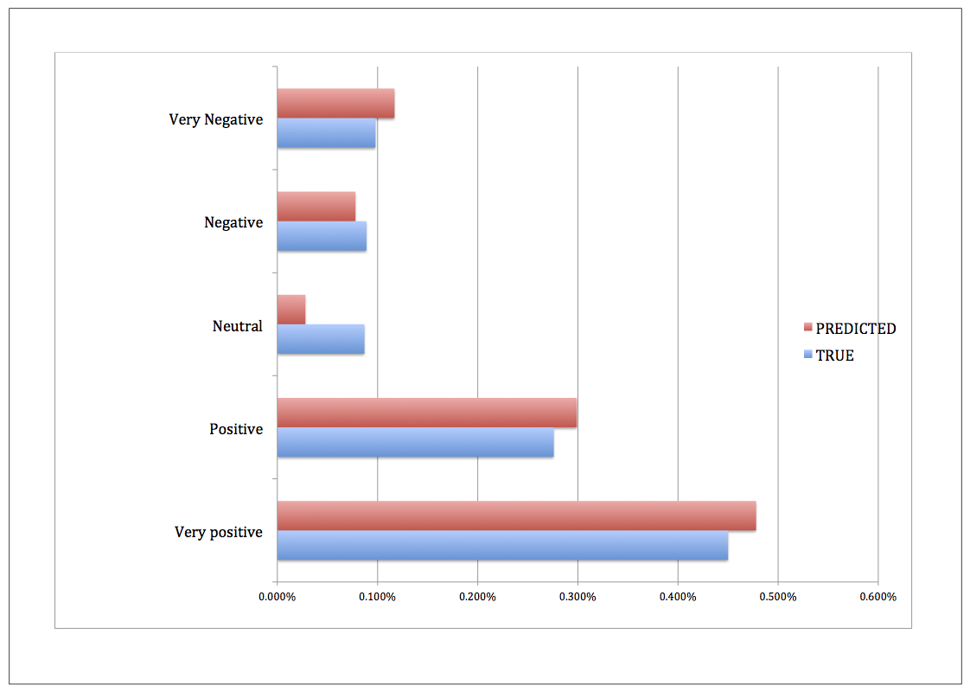
Sentiment Quantification
In many applications of sentiment classification (e.g., market research, social sciences, political sciences), estimating the relative proportions of Positive
/ Neutral / Negative documents is the real goal; this is called sentiment quantification¹⁰
E.g., tweets, product reviews
¹⁰A. Esuli and F. Sebastiani. Sentiment Quantification. IEEE Intelligent Systems, 2010.

Slide 66
Advanced Topics in Sentiment Analysis
Automatic generation of context-sensitive lexicons
Lexemes as complex objects in sentiment lexicons
Making sense of sarcasm / irony
Detecting emotion / sentiment in audio / video using non-verbal features
Cross-domain / cross-lingual / cross-cultural sentiment analysis

Slide 67
Further Reading
General:
B. Pang, L. Lee: Opinion Mining and Sentiment Analysis. Foundations and Trends in Information Retrieval, 2007.
B. Liu: Sentiment Analysis and Opinion Mining. Morgan & Claypool Publishers, 2012.
R. Feldman: Techniques and applications for sentiment analysis. Communications of the ACM, 2013.
C. Aggarwal: Chapter 13 of Machine Learning for Text, Springer, 2018.
Sentiment analysis in social media
S. Kiritchenko, X. Zhu, S. Mohammad: Sentiment Analysis of Short Informal Texts. Journal of Artificial Intelligence Research 50, 2014.
Mart´ınez-C`amara, E., Mart´ın-Valdivia, M., Uren˜a L´opez, L., and Montejo R´aez, A. Sentiment analysis in Twitter. Natural Language Engineering 20(1), 2014.

Slide 68
Questions?

